Slide 1
Social Media Estate Planning
Presented by:
Patricia E. Kefalas Dudek
&
Howard H. Collens

Slide 2
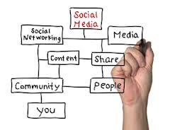
Digital Assets – What happens when I die?

Slide 3
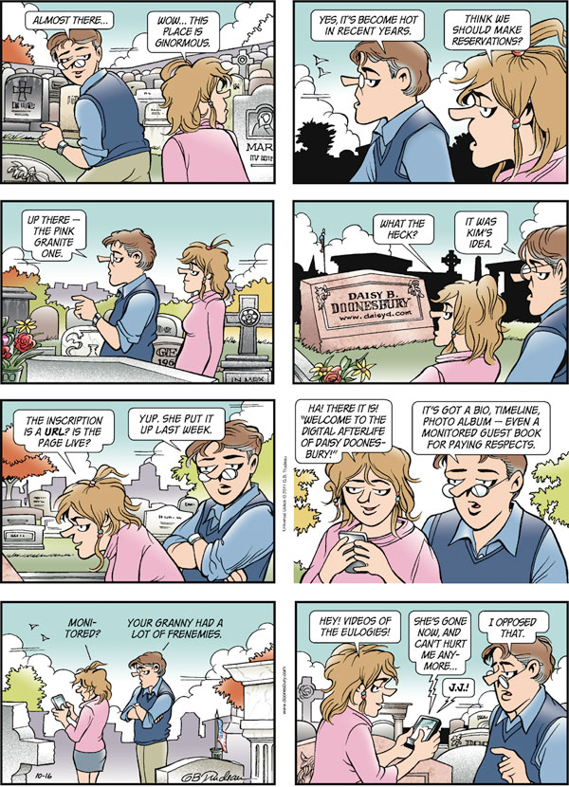

Slide 4
What are digital assets?
Digital assets come in a variety of forms, and are constantly changing, along with technology and social trends.
An individual may have a property ownership interest in an asset, or merely a license.
The term “digital assets” means, but is not limited to, files, including but not limited to, emails, documents, images, audio, video, and similar digital files which currently exists or may exist as technology develops or such comparable items as technology develops, stored on digital devices, including, but not limited to, desktops, laptops, tablets, peripherals, storage devices, mobile telephones, smart phones, and any similar digital device which currently exists or may exist as technology develops or such comparable items as technology develops, regardless of the ownership of the physical device upon which the digital asset is stored.
Excerpt from: The Elder Law Report, Vol. XXV, Number 1

Slide 5
Categories of Digital Assets
Personal
Stored on computers, smart phones, or other devices, or are uploaded to a Web site or digital service
Photographs, videos, emails, and music playlist
Social Media
May involve photos, videos and other electronic files stored on these accounts
Financial
Online banking, online bill-paying activities
Online accounts with no connection to a brick-and mortar establishment (Amazon, eBay, PayPal and E*TRADE)
Business
Varies by types of business and extent of its computer or Internet associated activities, which may include blogs, domain names, credit card and financial data

Slide 6
How do we assist clients in the planning?

Slide 7
Estate Planning for Digital Assets & Social Media Accounts
Make a list of your digital assets and accounts
Select a Successor
Provide Access
Provide Instructions
Additional resources
General Assignment of Digital Assets & Assignment of Digital Personal Representative
General Assignment of Property Including Digital Assets

Slide 8
Make a list
Hardware
Include computers (laptop, desktop, work computer)
Hard drives, flash drives
iPods
Cell phones
Social Media and Online Presence
Facebook, Twitter, LinkedIn, Flickr, YouTube
Your own website
Your blog
Sites which you store photos and/or work documents
Online Accounts
Bank and other financial accounts
Shopping sites
Site with your credit card information stored on them
Bonus Points
Airline Miles
Excerpt from: Estate Planning for Digital Assets and Social Media

Slide 9
Select a Successor
Think about whom you would want to access your computer, your email and your online accounts
It would be a good idea to talk to this person now and let them know your plans
Excerpt from: Estate Planning for Digital Assets and Social Media

Slide 10
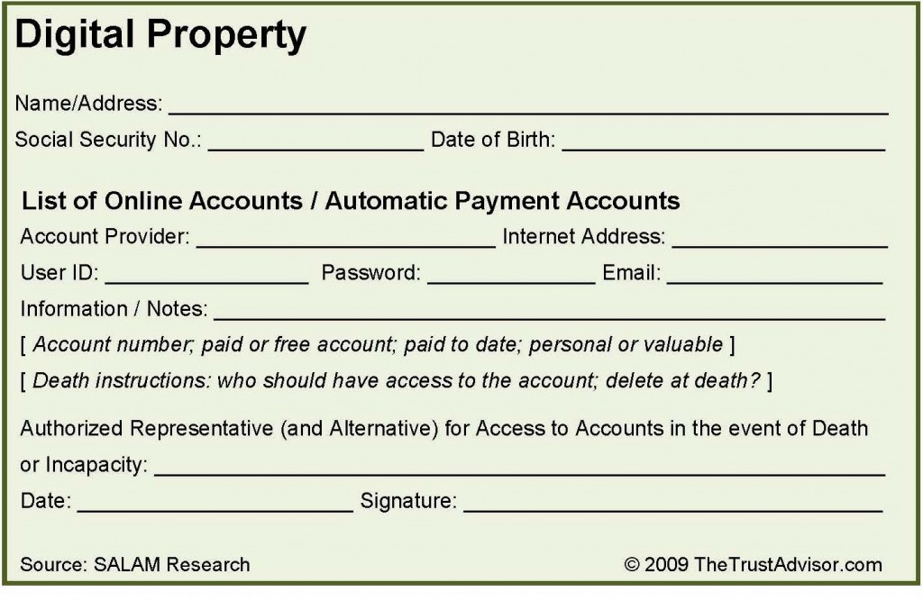
Provide Access
Create a document and note if the property is personal or has monetary value
Examples of note
Excerpt from: The Trust Advisor

Slide 11
Provide Instructions
If you want a site to continue, for example if you have a website or blog, you need to leave instructions for keeping it up or having someone take it over and continue it.
If a site is currently producing or could produce revenue (e-books, photography, videos, blogs), make sure your successor knows this.
If there are things on your computer or hard drive that you want to pass on (scanned family photos, ancestry research, a book you have been writing), put them in a “Do Not Delete” folder and include it on your inventory list.
Excerpt from: Estate Planning for Digital Assets and Social Media

Slide 12
Templates

Slide 14
Where should I note my intent?
Powers of Attorney
Sample language: Electronic and Social Media. To access any and all of my online accounts; to obtain, use or change any of my usernames and/or passwords to any of my online accounts; to manage, add, delete, modify, curate, archive, maintain, and increase access or limit access to any of my online content; to transfer ownership rights and to maintain, modify, delete, or cancel any of my online accounts. Such powers shall apply to all of my social media accounts, including but not limited to Facebook, Twitter, LinkedIn, corporate affinity and points programs, banking and financial institution on-line access points, any and all data and photo archiving sites, blogs and websites of mine whether I am maintaining such accounts in my individual name, through a business, through a pseudonym or anonymously.

Slide 15
Where should I note my intent?
Last Will and Testament
Sample Language: Electronic and Social Media. To access any and all of my online accounts; to obtain, use or change any of my usernames and/or passwords to any of my online accounts; to manage, add, delete, modify, curate, archive, maintain, and increase access or limit access to any of my online content; to transfer ownership rights and to maintain, modify, delete, or cancel any of my online accounts. Such powers shall apply to all of my social media accounts, including but not limited to Facebook, Twitter, LinkedIn, corporate affinity and points programs, banking and financial institution on-line access points, any and all data and photo archiving sites, blogs and websites of mine whether I am maintaining such accounts in my individual name, through a business, through a pseudonym or anonymously.

Slide 16
Where should I note my intent?
Revocable Living Trust
Sample Language: Electronic and Social Media. To access any and all of Settlor’s online accounts; to obtain, use or change any of Settlor’s usernames and/or passwords to any of Settlor’s online accounts; to manage, add, delete, modify, curate, archive, maintain, and increase access or limit access to any of Settlor’s online content; to transfer ownership rights and to maintain, modify, delete, or cancel any of Settlor’s online accounts. Such powers shall apply to all of Settlor’s social media accounts, including but not limited to Facebook, Twitter, LinkedIn, corporate affinity and points programs, banking and financial institution on-line access points, any and all data and photo archiving sites, blogs and websites of Settlor’s whether Settlor is maintaining such accounts in Settlor’s individual name, through a business, through a pseudonym or anonymously.

Slide 17
Where should I note my intent?
General Assignment
Sample Language: To the extent possible this assignment shall also act as delivery of all of my social media accounts, including but not limited to Facebook, Twitter, LinkedIn, any and all data and photo archiving sites, blogs and websites of mine whether I am maintaining such accounts in my individual name, through a pseudonym or anonymously.

Slide 18
INVENTORY
Decide “what has value” (not just financial value).
In addition to photos, emails, and social media sites, chances are you have invested $ online with no tangible products to show for it. Protect your property!
Personal information may be invaluable to your loved ones

Slide 19
Inventory Checklist
Make sure you include everything from your computer, other devices, and the “virtual world” (i.e. cloud, internet)
All email accounts
All social websites you participate in
Financial and commerce accounts
There are apps for this (My Eyes Only)
Make a simple spreadsheet with passwords to access assets
DIGITAL ASSET INVENTORY
Asset | Access | Wishes
Name | Contents | Location | Username | Password | Instructions | Recipient

Slide 20
Who is in charge?
After you inventory your digital assets, you must decide who to give the access to in the event of your death or disability.
Make sure you indicate whether you want your digital personal rep. to archive your content, share your content with others, or delete your content (and/or secure privacy of some content which may be harmful).
Make sure to include any special instructions (like deleting adult content so your grandma doesn’t run across it while searching your computer for family photos).

Slide 21
Incorporating Digital Estate Planning into Your Practice
Be aware of some common examples of digital assets
Email is one of the most vital because it serves as a doorway to online accounts
Think of digital assets as a “bundle of sticks”; your client may have ownership over a particular stick
Also important to know if client has a right in the “stick” or a right to use one of the “sticks”
To help the process, a questionnaire for the client to list all digital assets and the value of those assets
Discuss if any of the assets have financial value
Keep record of all passwords and profiles
There are websites specifically designed to release account information after death to designated beneficiaries (Legacylocker.com or AssetLock.net)
Suggest clients protect significant data with strong encryption

Slide 22
Valuing Digital Assets
For federal transfer tax purpose, digital property should be valued the same way as other property
Some types of digital assets are more difficult
A few blogs/web pages may receive cash flow from advertising or the like, which can be used to establish value
Internet domain names can be bought and sold but typically have very little financial value
Even some video game characters and their virtual currency and items have web-based marketplaces where sales occur.
Determining a price for these virtual items can be extremely challenging or even impossible since these items only exist in the virtual world.
Law firm digital access concerns

Slide 23
What happens to my personal cyberspace?

Slide 24
FACEBOOK
One option: Memorialize the account
“When a user passes away, we memorialize their account to protect their privacy. Memorializing an account sets the account privacy so that only confirmed friends can see the timeline or locate it in search. Friends and family can leave posts in remembrance.” Link for form to get page memorialized
Terms of service mention that they will not issue login and password information to family members of a person who has died
Memorial accounts can never be logged into again
Spokesman, Tucker Bounds, mentioned that a download of the account’s data will be provided for the estate “if prior consent is obtained from or decreed by the decreased, or mandated by law”
Second Option: Ask to have profile removed or deleted
Need to submit
The deceased's birth certificate
The deceased's death certificate
Proof of authority under local law that you are the lawful representative of the deceased or his/her estate
From: Facebook

Slide 25
TWITTER
In the event of the death of a Twitter user, we can close the account and help family members recover public Tweets from the account.
Please provide us the following:
A copy of the user’s death certificate
A copy of your government-issued ID
The username of the Twitter account, or a link to the account's public profile page.
A signed, notarized statement that includes:
A link to a public obituary article or the obituary from the local newspaper (optional)
Your first and last name
Your current contact information
Your email address
Your relationship to the deceased user
Action requested (e.g., ‘please deactivate the Twitter account’)
You may contact us at privacy@twitter.com, by fax, or by mail at the following address :
Twitter Inc., c/o: Trust & Safety 795 Folsom Street, Suite 600 San Francisco, CA 94107 Fax : 415-222-9958
We conduct all of our communication via email; should we require any other information, we will contact you at the email address you have provided in your request
*Please note: We are unable to provide login information for the account to anyone regardless of his or her relationship to the deceased.*
(From Twitter: How to Contact Twitter About a Deceased User

Slide 26
Linked In
Memorialize the account
If we learn that a User is deceased, we may memorialize the User’s account. In these cases we may restrict profile access, remove messaging functionality, and close an account if we receive a formal request from the User’s next of kin or other proper legal request to do so.
Verification of Death- Deceased User form
From: Linked In

Slide 27
iTunes
When you purchase digital files (music, movies, books), you have merely purchased a license for personal use.
Apple’s Terms of Service has a provision covering nuclear weapons – but nothing specifically about the transfer of your media upon death or disability.
It appears that legally – for now – there is no way to transfer iTunes media upon death or disability.
From Apple.com…10. Export Control. You may not use or otherwise export or reexport the Apple Software except as authorized by United States law and the laws of the jurisdiction in which the Apple. Software was obtained. In particular, but without limitation, the Apple Software may not be exported or re-exported (a) into any U.S. embargoed countries or (b) to anyone on the U.S.Treasury Department's list of Specially Designated Nationals or the U.S. Department of Commerce Denied Person’s List or Entity List. By using the Apple Software, you represent and warrant that you are not located in any such country or on any such list. You also agree that you will not use these products for any purposes prohibited by United States law, including, without
limitation, the development, design, manufacture or production of missiles, or nuclear, chemical or biological weapons.

Slide 28
iTunes
Customers own a license to use digital files
Apple grants “nontransferable” rights to use content
Limits use of files to Apple devices used by the account holder
Digital music downloads do not work the same way physical content does
Restrictions even when alive to prevent person from lending, sharing or burning music to a CD
Section B of iTunes terms of service agreement says “iTunes is the provider of the Service, which permits you to purchase or rent a license for digital content ("iTunes Products") for end user use only under the terms and conditions set forth in this Agreement.”
Story: Bruce Willis was going to sue Apple over the right to who gets his iTunes collection after his death but the story was just an over-exaggeration that raised an interesting point.
From: iTunes

Slide 29
Other Posthumous Options

Slide 30
Posthumous Options
Have your digital personal rep. add an auto response on your email account for a set number months…
-Example: “This email address is no longer being checked because John Doe is no longer alive. Please send any condolences to his family at doe@comcast.net”
They could also send a “final tweet or post” to your friends, if those are your wishes.

Slide 31
Posthumous Options
Greatgoodbye.com-This site sends an email for you (written by you in advance) upon notice of your death.
Sites like this don’t require relying on a human to send your final messages to your friends and family.
There are also many online memorial sites, including…
-Bcelebrated.com
-Online-Legacy.com
-MyWonderfulLife.com

Slide 32
The Law

Slide 33
The Law Says…..
Like anything else, if you don’t have your wishes clearly expressed at the time of your death, your digital assets will be distributed according to the laws of the state you were residing.
Social media companies have relied on terms of service to guide them because of the lack of legislation related to digital property after death.
Only five states have passed legislation regarding digital assets (Oklahoma, Idaho, Rhode Island, Indiana, Virginia, Nevada and Connecticut, who was the first in 2005) http://mashable.com/2012/01/26/digital-assets-after-death/
Do not include usernames and passwords in your documents (especially your will). Once a will is filed, it becomes part of the public record.
Hopefully firms will start asking about digital content on their estate planning intake forms.

Slide 34
The Law Says…..
The Uniform Law Commission appointed a Drafting Committee on Fiduciary Access to Digital Assets to prepare a model act on this topic, and they have a working draft that is expected to be finalized in 2014. As of August 30, 2013, other states have already introduced or are considering introducing new legislation to address fiduciary access to digital property, although we believe that several of these proposals are too limited in scope:

Slide 35
The Law Says…..
California.
Colorado.
Florida.
Maine: Legislative Document 850, passed May 21, 2013, appointed a commission to study the legal impediments to the disposition of digital assets upon an individual’s death or incapacity and develop legislative recommendations based on the study by December 1, 2013.
Maryland: Senate Bill 29 introduced January 9, 2013, status (note: this bill received an “unfavorable” report by the Senate Judicial Proceedings Committee on February 14, 2013).
Massachusetts: Senate Bill 702 (House Bill 1314), introduced January 22, 2013, status (see also Senate Bill 754, introduced January 24, 2011, Senate Bill 2205 introduced April 5, 2012, and Senate Bill 2313 introduced June 21, 2012).

Slide 36
The Law Says…..
Michigan: House Bill 5929 introduced September 20, 2012, status, and Senate Bill 293 introduced April 10, 2013, status.
Missouri.
Nebraska: Legislative Bill 783 introduced January 5, 2012, status (note: this bill was indefinitely postponed as of April 18, 2013).
New Hampshire: House Bill 116 introduced January 3, 2013, status.
New Jersey: Assembly Bill 2943 introduced May 14, 2012, status.
New York: Bill A823–2013 introduced January 9, 2013, status; Bill A6034–2013 introduced March 13, 2013, status; and Bill A6729–2013 introduced April 17, 2013, status

Slide 37
The Law Says…..
North Carolina Senate Bill 279 introduced March 12, 2013, status (note: the digital asset provisions contained in the first two versions of this bill were removed before this bill was signed into law June 12, 2013).
North Dakota: House Bill 1455 introduced January 21, 2013, status (note: this bill did not pass the vote taken in April 2013).
Ohio.
Oregon Senate Bill 54 introduced January 14, 2013, status.
Pennsylvania: House Bill 2580 introduced August 23, 2012, status.
Virginia: Senate Bill 914 introduced January 7, 2013, status.

Slide 38
Assign Digital Assets in a Trust
Here digital assets are transferred into the trust during the client’s lifetime (if permitted).
Much of your digital content is not owned by you, but licensed to you during your lifetime. The license ends at death/disability. However, if you have transferred the digital media to a trust, the assets should survive past your death since the trust does not terminate on death.
This is a good option because you can easily update the trust, and this way your digital contents remain private while avoiding probate.
You can have the same trustee or different ones for digital assets.

Slide 39
Uniform Law Commission
Approved a study committee on fiduciary power and authority to access digital property and online accounts during incapacity and after death in April 2012
Charge with “considering and making recommendations concerning the need for and feasibility of drafting a uniform act on the authority and powers of a fiduciary to access digital information related to a decedent’s estate or the affairs of an incapacitated individual”
Link - http://www.uniformlaws.org/Committee.aspx?title=Fiduciary%20Access%20to%20Digital%20Assets

Slide 40
Uniform Law Commission
The Fiduciary Access to Digital Assets Drafting Committee has met several times. The latest draft of the Fiduciary Access to Digital Assets Act is intended to “vest fiduciaries with the authority to access, manage, distribute, copy or delete digital assets and accounts. It addresses four different types of fiduciaries: personal representatives of decedents’ estates, conservators for protected persons, agents acting pursuant to a power of attorney, and trustees.”
The FADAA is intended as a stand alone act
The draft is still subject to modification

Slide 41
Developments in Michigan
There is no current Michigan law that comprehensively addresses how digital assets should be managed by a fiduciary.
A very limited version of digital assets legislation was introduced in the State House in 2012 with no action taken. http://www.legislature.mi.gov/%28S%28k31w52qhnyjglw45yr1k5z45%29%29/mileg.aspx?page=GetObject&objectname=2012-HB-5929
Another was introduced in the State Senate in 2013 with no action taken. http://www.legislature.mi.gov/%28S%28rrhk3n2u1iptbe55scnvup45%29%29/mileg.aspx?page=GetObject&objectname=2013-SB-0293
The Updating Michigan Law Committee of the Probate and Estate Planning Section is currently working to draft a proposal for digital assets legislation in Michigan
Stay tuned

Slide 42
ADDITIONAL REFERENCES

Slide 43
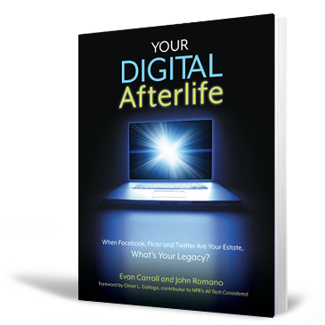
By: Evan Carroll & John Romano
About the Book
Almost without realizing it, we have shifted toward an all-digital culture. Future heirlooms like family photos, home movies, and personal letters now exist only in digital form, and in many cases they are stored using popular services like Flickr, YouTube, and Gmail. These digital possessions form a rich collection that chronicles our lives and connects us to each other.

Slide 44
Password Keepers
RoboForm.com-stores all your passwords in one place and allows you instant access into all your frequented websites.
StickyPassword.com-password manager and online form-filler.
Aurora Password Manager on www.animabilis.com-stores website and email access passwords, helps you create unbreakable passwords.

Slide 45
Online Resources
The Elder Law Report, Volume XXV, Number 1, July/August 2013
PDF - The ElderLaw Report.pdf
Who gets your digital fortune when you die?
Link - http://www.marketwatch.com/story/who-gets-your-digital-fortune-when-you-die-2014-01-10
What Happens When We Die: Estate Planning of Digital Assets
PDF - http://commlaw.cua.edu/res/docs/21-1/Perrone.pdf
Estate Planning for Digital Assets and Social Media
Link - http://www.estateplanning.com/Estate-Planning-for-Digital-Assets-and-Social-Media/

Slide 46
Online Resources
Estate Planning & Social Media: What Happens to Your Accounts?
Link - http://blog.equifax.com/retirement/estate-planning-and-social-media-what-happens-to-your-accounts/
Estate Planning Today Must Include Digital Assets & Social Media
Link - http://estateplanninglawyersandiego.com/estate-planning-today-must-include-digital-assets-and-social-media/
Bequeathing the Keys to Your Digital Afterlife
Link - http://www.nytimes.com/2013/05/26/technology/estate-planning-is-important-for-your-online-assets-too.html?_r=0

Slide 47
Online Resources
Managing Your Digital Afterlife: Cyber Footprint, Ownership & Access
Link - http://thetrustadvisor.com/tag/digital-estate-planning
What Happens to Your Digital Life After Death?
Link - http://www.pewresearch.org/fact-tank/2013/12/02/what-happens-to-your-digital-life-after-death/
Fiduciary Access to Digital Assets
Link - http://www.uniformlaws.org/Committee.aspx?title=Fiduciary%20Access%20to%20Digital%20Assets

Slide 48
Online Resources
Digital Assets – By: Jennifer VanderVeen, CELA
Link - https://www.naela.org/NAELADocs/PDF/Library%20Tab/NAELANews_Vol25No5TwoPg.pdf (Page 13)
What Happens to Your Blog After Your Death?
Link - http://www.legalnews.com/ingham/1294315
What Dies Managing a Loved One’s Digital Legacy Look Like?
Link - http://www.huffingtonpost.com/rev-amy-ziettlow/what-does-managing-a-love_b_3461477.html
Your Digital Will: How to Share Your Date After Death
Link - http://www.foxnews.com/tech/2012/08/30/your-digital-will-how-to-share-your-data-after-death/
Life & Death Online: Who Controls a Digital Legacy?
Link - http://online.wsj.com/news/articles/SB10001424127887324677204578188220364231346

Slide 49
From Estate Planning for Digital Assets: Are you Incorporating This Into Your Practice? Michigan Probate & Estate Planning
Jessica Arends, Esq.
Cunningham Dalman, PC
PO Box 1767 321 Settlers Road Holland, MI 49422-1767
616.392.1821 Ext. 280
jessica@holland-law.com
P. Haans Mulder, Esq.
Cunningham Dalman, PC
PO Box 1767 321 Settlers Road Holland, MI 49422-1767
616.392.1821 Ext. 256
phmulder@holland-law.com

Slide 50
From Smart Money Magazine “Protecting Your Virtual Estate”
Tania Karas
Smart Money Magazine
1211 Avenue of the Americas New York, NY 10036
letters@smartmoney.com
@taniakaras

Slide 51
From Estate Planning 2.0: Digital Property and Tech-Savvy Clients- Time to Reboot Your Practice: Presented at the 45th Annual Heckerling Institute on Estate Planning, Orlando, Florida, on January 12, 2011
James D. Lamm
Gray Plant Mooty
80 South Eighth Street, Suite 500
Minneapolis, MN 55402
612.632.3404
James.Lamm@gpmlaw.com

Slide 52
David A. Shulman, Esq. Law Offices of David A. Shulman, PL 401 E. Las Olas Blvd. Suite 130-491 Fort Lauderdale, FL 33301 954.990.0896 david@davidshulmanlaw.com www.sofloridaestateplanning.com
From Estate Planning for Digital Assets and Online Financial Accounts: A live 90 minute webinar presented on July 27, 2011

Slide 53
Nathan J. Dosch, JD, MST Grant Thornton, LLP 100 E. Wisconsin Avenue, Suite 2100 Milwaukee, WI 53202-4169 414.277.6491
From Estate Planning for Digital Assets and Online Financial Accounts: A live 90 minute webinar presented on July 27, 2011

Slide 54
PRESENTERS

Slide 55
Patricia E. Kefalas Dudek Patricia E. Kefalas Dudek & Associates 30445 Northwestern Highway Suite 250 Farmington Hills, MI 48334 248.254.3462 pdudek@pekdadvocacy.com www.pekdadvocacy.com Twitter: @PattiDudek

Slide 56
Howard H. Collens Galloway and Collens, PLLC 26075 Woodward Ave, Suite 200 Huntington Woods, Michigan 48070 248.545.2500 GallowayCollens.com Howard@GallowayCollens.com Twitter: @howardcollens

